Slide 1
Measuring in Science

Slide 2
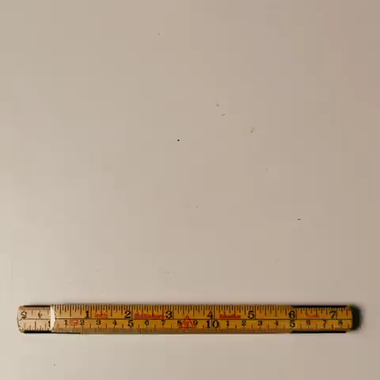
By the end of this lesson:
Name the equipment used to measure length, volume, angles, weight and temperature
Use the equipment to make different measurements.

Slide 3
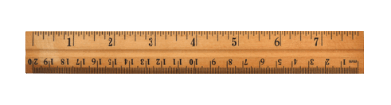
For measuring length, we have rulers and tape measures.
A ruler has regularly spaced marks on it that show how long something is in centimetres (cm) or millimetres (mm).

Slide 4
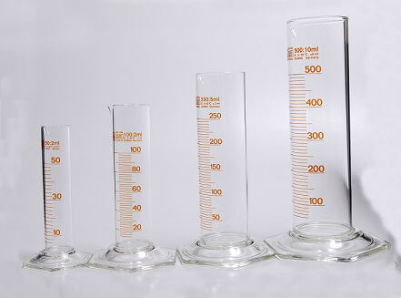
Quite often we have to measure the volume of objects.
To measure the volume of something, we can use a measuring cylinder or other glass container with marks on the side.
A measuring cylinder shows the volume of liquid inside it in millilitres (mL).

Slide 5
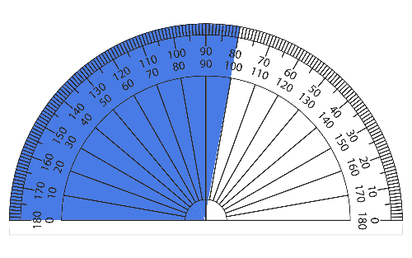
Sometimes you need to measure angles, like when something is moving in a circle.
To do this, we use a protractor.
A protractor can show the angle between two lines in degrees up to 180∘.

Slide 6
A protractor has two rows of numbers: an inside and an outside.
You use the inside if measuring from the left and the outside when measuring from the right.
In the picture below, to measure the blue angle you measure from the left using the inside row of numbers.
It goes from 0∘ to 100∘ so the angle is 100∘.

Slide 7

A thermometer is filled with red fluid that expands as it gets hotter.
The level this red fluid reaches gives you the temperature. It is measured in degrees Celsius (∘C).

Slide 8
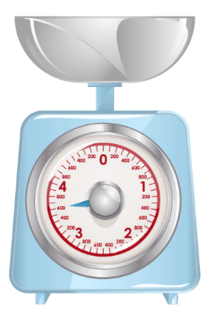
A kitchen scale is a device used to measure the weight of an object.
Weight is measured in kilograms (as a mass) or newtons (as a force). In the examples in this lesson, we will use kilograms.

Slide 9
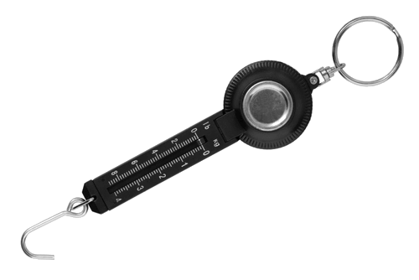
A spring balance is used to measure the size of a force in newtons (N). It has a hook at one end that can be attached to another object.
Inside is a spring that stretches more as more force is applied to it.
Weight is a type of force, so it can also be used to measure an object's weight.

